Slide 1
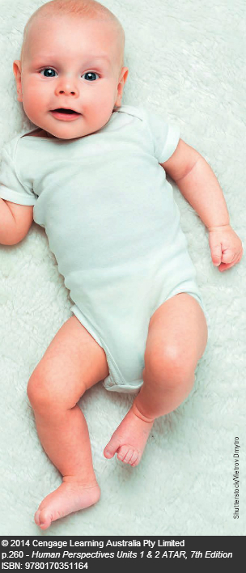
Chapter 19 Birth & Development

Slide 2
Quiz
1.What is another word for pregnancy?
2. What is the average weight of a newborn baby?
Gestation
3300 grams

Slide 3
3. What is the length of a full term pregnancy?
4. What is another word for birth?
5. The event just before the actual birth is called _________________.
280 days from last menstruation
Parturition
labour

Slide 4
Prior to Labour
Hormonal changes cause:
-the ligaments of the pelvis to soften, making the ligaments more pliable for childbirth.
-the uterus becomes more responsive to stimuli and the contractions of its muscles strengthen.

Slide 5
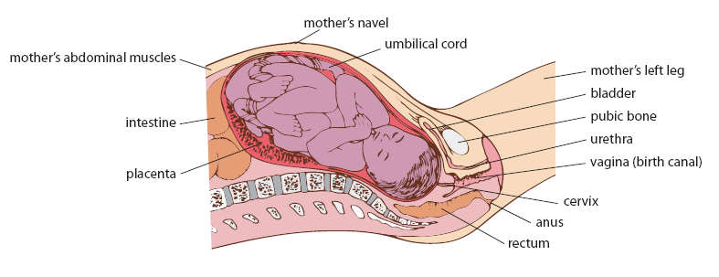
The Foetus Just Before Birth

Slide 6
The foetus’ head settles in the head of the mother’s pelvis.
The cervix has softened, shortened in length and possibly opened a little.
The foetus is facing one of the hip bones, knees up and legs crossed. This position takes up as little room as possible.

Slide 7
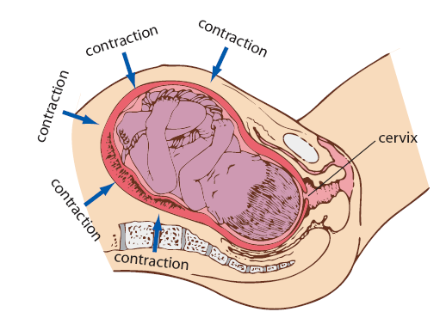
The First Stage of Labour

Slide 8
1st Stage of Labour
Onset of Labour pains:
Beginning of labour
They are contractions of the uterus muscles which have probably started during the final three months of gestation.
They become stronger, they increase in length and become more frequent.
At the beginning of the birth process, the contractions occur every 30 minutes and are quite strong.

Slide 9
Dilation of the Cervix-1st Stage of Labour
The first stage of labour is the time from the onset of labour to the complete dilation of the cervix.
On average, it lasts 8-9 hours for the first child and then shorter (4 hours) for subsequent children.

Slide 10
Contractions travel from the upper part of the uterus towards the cervix.
During each contraction, the muscle fibres of the uterus shorten which pulls on the cervix.
This pulls the cervix open causing cervical dilation.
The foetus is now able to move more deeply into the pelvis.

Slide 11
When the cervix is fully dilated(10cm), the uterus, cervix and vagina form a single passage called the birth canal.
The complete dilation of the cervix marks the end of the first stage of labour.

Slide 12
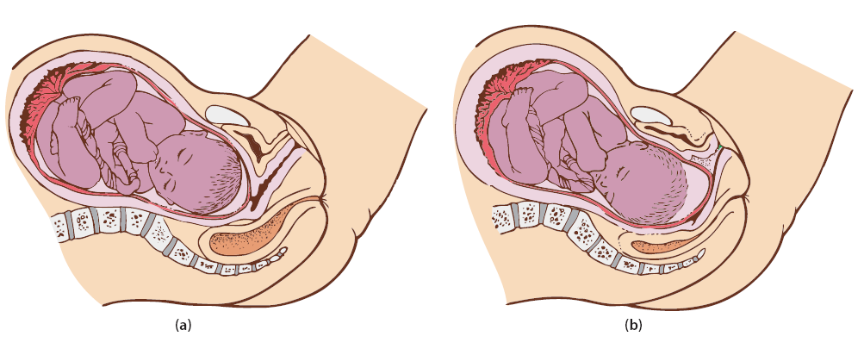
Late in the first stage of labour: the cervix has almost completely opened and the amnion is bulging in front of the head.
The baby is in early labour; at this stage the amnion is still intact

Slide 13
The Second Stage of Labour: Stage of Expulsion
Involves the delivery of the foetus
It frequently begins with the bursting of the amniotic membrane and a gush of fluid from the vagina.
It lasts from 20 minutes to 2 hours.
Contractions of the abdominal muscles and uterus push the foetus through the vagina.

Slide 14
With each contraction the head advances and between contractions it retreats.
The mother’s heart rate increases, she sweats and she is working very hard.
The opening of the vagina becomes very stretched.
Once the head has emerged, the baby’s head turns sideways which allows the shoulders and the body to move more easily through the birth canal.

Slide 15
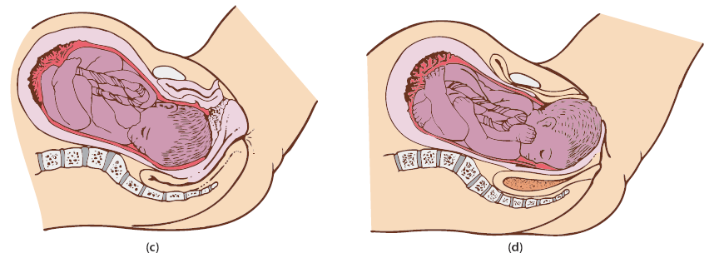
Early in the second stage: the baby’s head is starting to turn so that it faces towards the mother’s back and the amnion has ruptured.
Late in the second stage: the baby’s head appears at the entrance to the vagina and its shoulders are turning to fit into the bones of the pelvis; at this stage the face is turned completely towards the mother’s back.

Slide 16
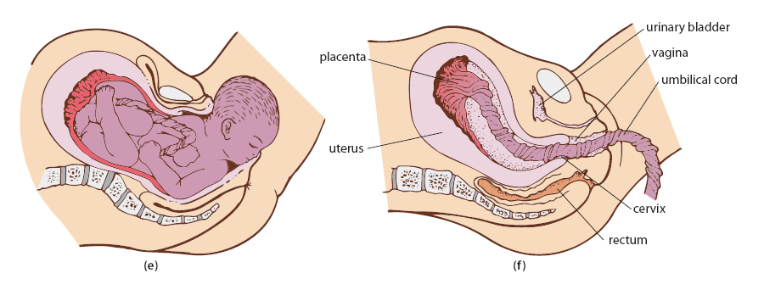
The baby’s head emerges from the vagina
The third stage of labour: the afterbirth is expelled from the uterus.

Slide 17
The 3rd Stage of Labour: Afterbirth
Once born, the baby breathes on its own; the umbilical cord is clamped and then cut.
After a few days, the stump of the cord falls off and the navel or umbilicus remains.
The baby is covered with a waxy material called vernix. It is a protective layer that reduces the incidence of skin infections.

Slide 18
The uterus continues to contract until the placenta and other membranes are expelled. This is called the afterbirth.
In the past, many women died from infections of the uterus. However, now with high health standards and antibiotics, it is rare when a woman dies from infection following childbirth.

Slide 19
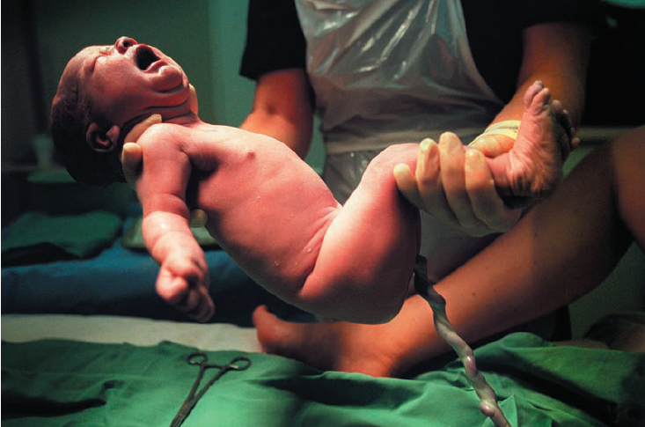
Characteristics of a Newborn Infant

Slide 20
50 cm long, 3.3 kg
Males are slightly larger than females
The head is about ¼ the length of the body.
It has little muscle control.
Reflexes control most of the movement of newborn babies.

Slide 21
POSTNATAL CARE
Body Temperature: Newborns have a large body surface area to volume ratio. This means that they can lose or gain heat much more rapidly than larger people. Care must be taken to keep babies warm in cold conditions and cool in hot conditions.
Water Balance: Newborns are prone to losing water particularly in hot conditions. The parents must make sure there is sufficient fluid intake to compensate for this.
Infection: Newborns are prone to infection and should be kept in clean, warm and dry environment to reduce the risk of infection.
Diet/Nutrition: Normal growth and development depends on the child’s postnatal diet.

Slide 22
Changes in the Baby at Birth
The foetus is totally dependent on the mother for oxygen and nutrition as well as the elimination of wastes via the placenta.
It is also protected against change of temperature, shocks and many disease-causing organisms.
After birth, the baby must become self-supporting.

Slide 23
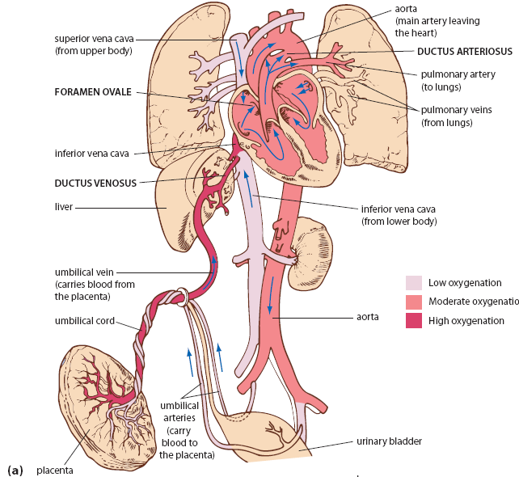
Foetal Circulation

Slide 24
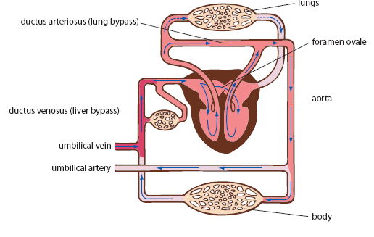
Schematic Diagram Showing Foetal Flow of Blood

Slide 25
Circulation of Blood in a Foetus
The ductus arteriosus and foramen ovale act to reduce blood flow to the lungs.
The ductus arteriosus diverts blood from the pulmonary artery to the aorta.
The foramen ovale diverts blood from the right atrium directly to the left atrium.
Only part of the blood flows through the liver and then into the inferior vena cava
The rest of the blood bypasses the liver by going through the ductus venosus.

Slide 26
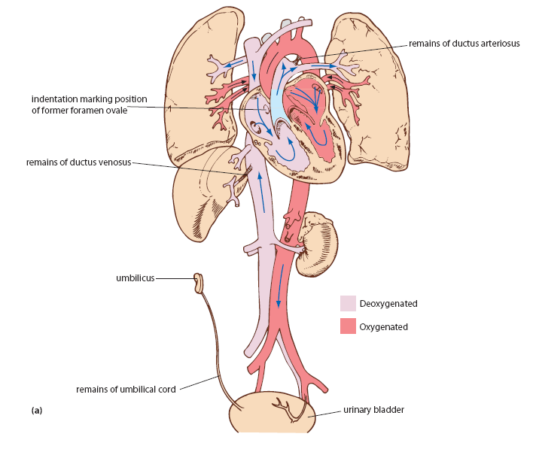
Changes in the Circulation at Birth

Slide 27
At birth the umbilical arteries and vein are clamped stopping blood flow through them.
The baby must now rely on its own lungs to provide the oxygen
Flow through the ductus arteriosus decreases and it closes up.
As more blood returns from the lungs to the left atrium, this increases the pressure in the left atrium closing the foramen ovale.
It eventually closes permanently.

Slide 28
The ventricles continue to pump blood into the aorta and pulmonary artery.
After the umbilical cord is cut, blood no longer flows through the ductus venosus and it eventually closes off so that all the blood from the hepatic portal vein must pass through the liver.

Slide 29
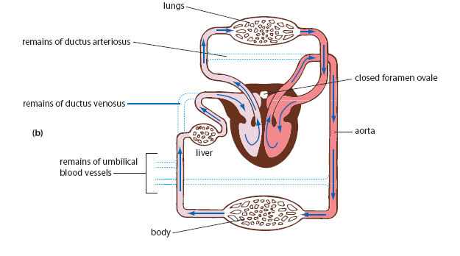
Schematic Diagram Showing Changes in the Circulatory System During Birth

Slide 30
Baby’s breathing rate is high(94 breaths/min)
It’s heart rate is 125-130 beats/min
Increased red blood cells
Why?
More oxygen is needed for increased muscular activity
To keep the baby warm in the external environment.
The white blood cell count is high at birth and then decreases after a week.

Slide 31
Changes to the Mother
1. Reproductive organs slowly return to their original state. This stage is called puerperium.
2. Abdomen flattens
3. Discharge from slowly shrinking uterus.
4. Return of menstruation.
5. Onset of lactation
6. Physiological Changes: blood volume decreases to normal, heart rate becomes slower
7. Post partum blues (Post-Natal Depression)

Slide 32
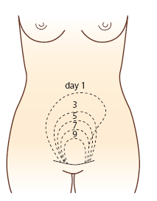
The uterus returning to its normal size

Slide 33
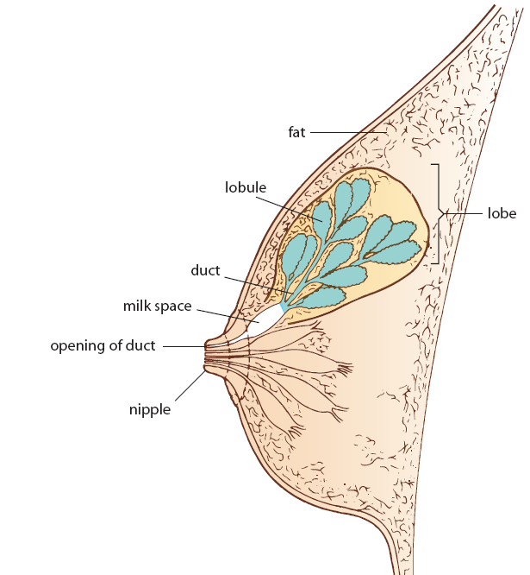
Structure of the Breast

Slide 34
Structure of the Breast
Female breast consists of 15 – 25 sections called lobes.
Each lobe is subdivided into a number of lobules.
The wall of each lobule is made up of a large number of glandular alveoli.
These alveoli are the milk-secreting regions of the breast

Slide 35
From lobules the ducts open into the wide space
These spaces serve as reservoirs.
Each lobe has its own milk space
There are 15-25 openings on the nipples
Lobules and lobes are surrounded by fatty connective tissues.
This gives the breast its rounded contour

Slide 36
Define the term ‘lactation’.
The initiation and maintenance of milk production and the delivery of the milk to the baby.

Slide 37
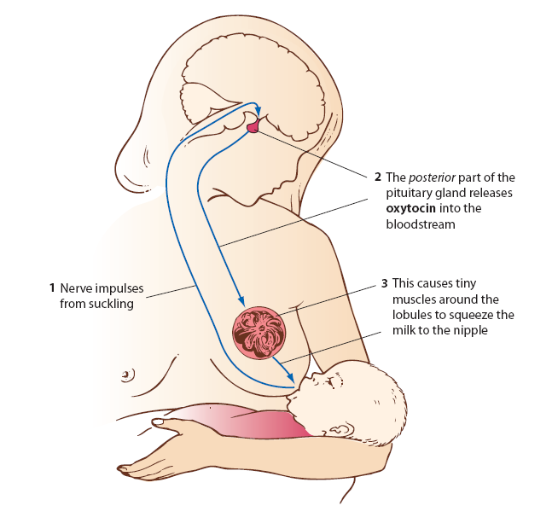
Milk Let-Down

Slide 38
The Role of Prolactin and Oxytocin in the Production and Release(milk letdown) of Milk.
In late pregnancy prolactin causes the growth and development of the breast.
After birth the decrease in oestrogen and progesterone allow the presence of prolactin to stimulate the development of breasts.
The suckling of the baby at the nipple stimulates the release of oxytocin from the posterior lobe of the pituitary gland.
This causes the muscles around the lobules to release the milk into the ducts.

Slide 39
Colostrum
First secretion from the breast following birth
A watery, yellowish-white fluid containing nutrients
Not vital for nutrition, however, it does have certain advantages for the infant
Provides fluid necessary for the baby and also antibodies for temporary immunisation to the diseases to which the mother is also immune.

Slide 40
A Table Comparing Breast Milk and Cow’s Milk
 | Breast Milk | Cow’s Milk
Protein | Low | 3 times more than breast milk
Digestibility | Easy to digest | Hard to digest
Lactose | High | Only 2/3 of breast milk
Vitamins/ Minerals | High in Ca, Low in K, P, Na, Fe | Low in Ca Higher in K, P, Na, Fe

Slide 41
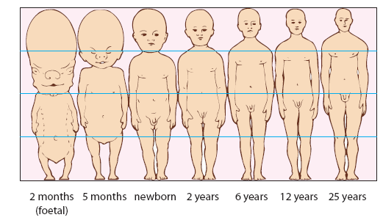
Changes in Form and Proportion of the Human Body

Slide 42
Changes in Physical Proportion that Occur in Development From Infancy to Childhood.
Leg Length
At birth an infants legs take up approximately 1/3 of the body length.
From 2 months of age the legs start to grow rapidly until at full adult size the legs comprise approximately ½ the body length.

Slide 43
Head Size
At birth an infant’s head takes up approximately ¼ of the body length.
By adult size, the head takes up about 1/10 of the body length.

